Slide 1


Page 01
A PROJECT
ON
BIKE SHARING RENTAL

Slide 2

Page 02
PROJECT OBJECTIVES
Accurately Predict Bike Rental Demand:- Build a reliable machine learning model that forecasts rental demand based on external factors such as weather, season, hours, holidays, and time of day.
Optimize Bike Availability :- Ensure a stable supply of rental bikes in urban cities to reduce customer waiting time and improve mobility comfort.
Enhance Customer Satisfaction:- Provide seamless access to bikes by minimizing shortages and ensuring demand is met efficiently.
Support Business Decision-Making:- Deliver actionable insights that help bike-sharing companies optimize operations, pricing strategies, and marketing efforts.
Leverage Data-Driven Insights:- Use exploratory data analysis and visualization to uncover demand patterns and seasonality, guiding both model development and business strategies.
Deploy a Scalable Solution:-Implement the best-performing model in a production environment with a user-friendly interface for real-time predictions.

Slide 3
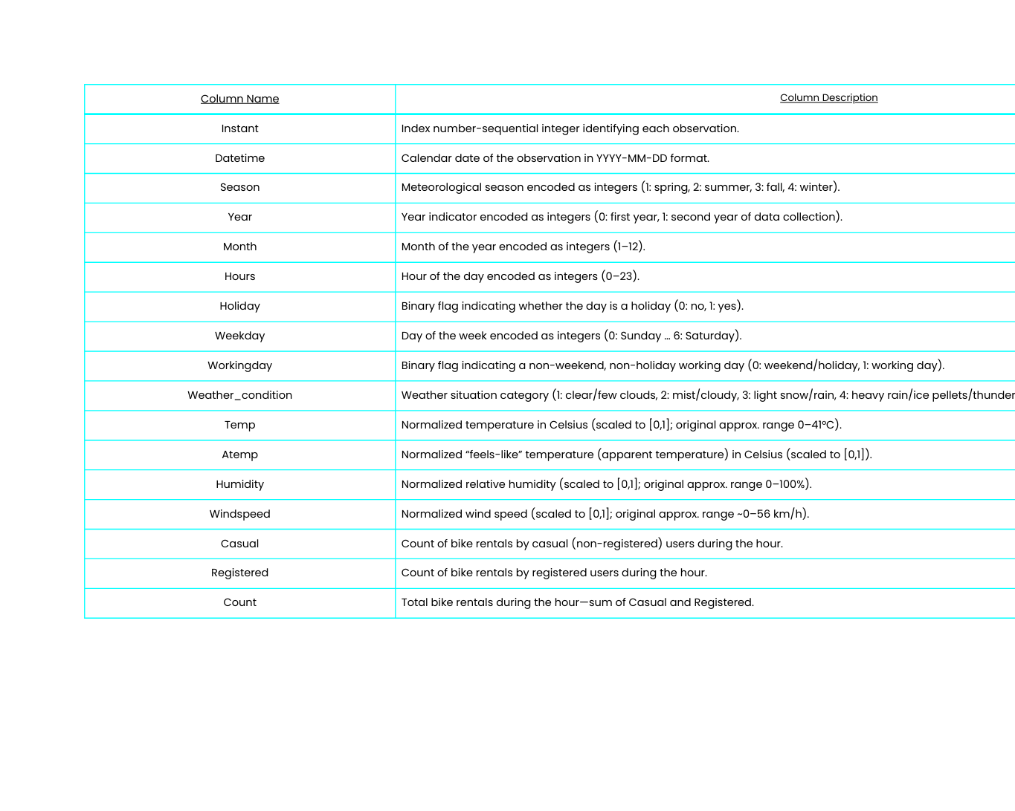
Page 03
DATA DESCRIPTION

Slide 4

Page 04
EXPLORATORY DATA ANALYSIS (EDA)

Slide 5
Page 05
DATA PREPARATION & CLEANING
There are no duplicate rows in the dataset.
There are unique symbols or missing values in the dataset.
Changed the columns name for better understanding of variables. (like rec_id, datetime, year, month, hours, weather_condition, temp, atemp, humidity, count)
Changed the data types of numerical columns which represents categories. (like season, year, month, temp, atemp, humidity, windspeed, casual, registered, count to categorical data type).
There are null values in the columns, so imputed categorical features with the mode and numerical features with the median using KNN Imputer.

Slide 6

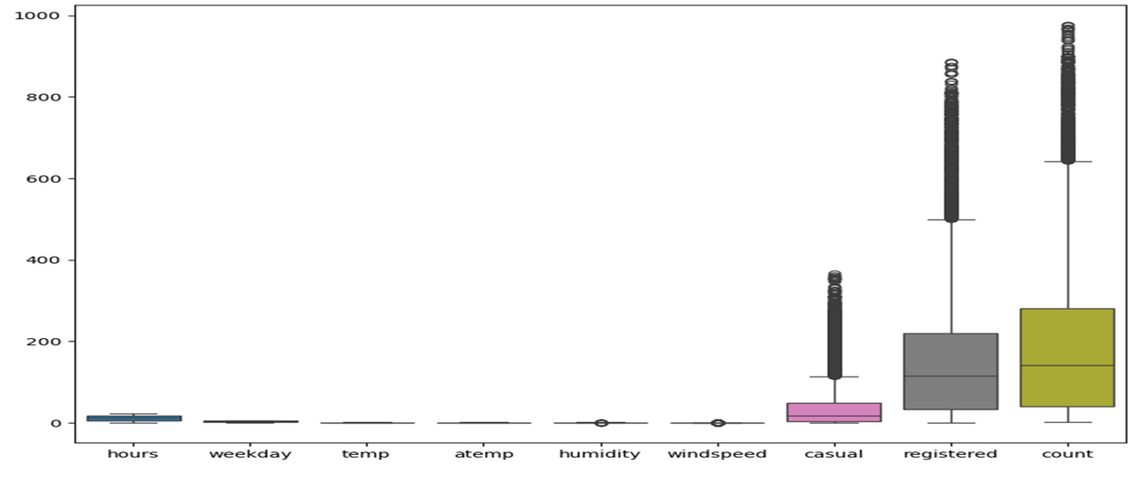
Page 06
OUTLIER ANALYSIS OUTCOME
Boxplot visualization revealed significant outliers in the variables casual ,registered and count indicating high variability in user behaviour and demand.
These data points represent real-world behavior (e.g., weekend, holidays, weather shifts) and carry valuable predictive signals.
Removing outliers was avoided as it lead to degraded model performance and loss of critical variance.
Instead the model was trained with outliers intact to preserve data richness and improve generalization.
Outliers detected in hours: 0
Outliers detected in weekday: 0
Outliers detected in temp: 0
Outliers detected in atemp: 0
Outliers detected in humidity: 22
Outliers detected in windspeed: 341
Outliers detected in casual: 1192
Outliers detected in registered: 680
Outliers detected in count: 505

Slide 7
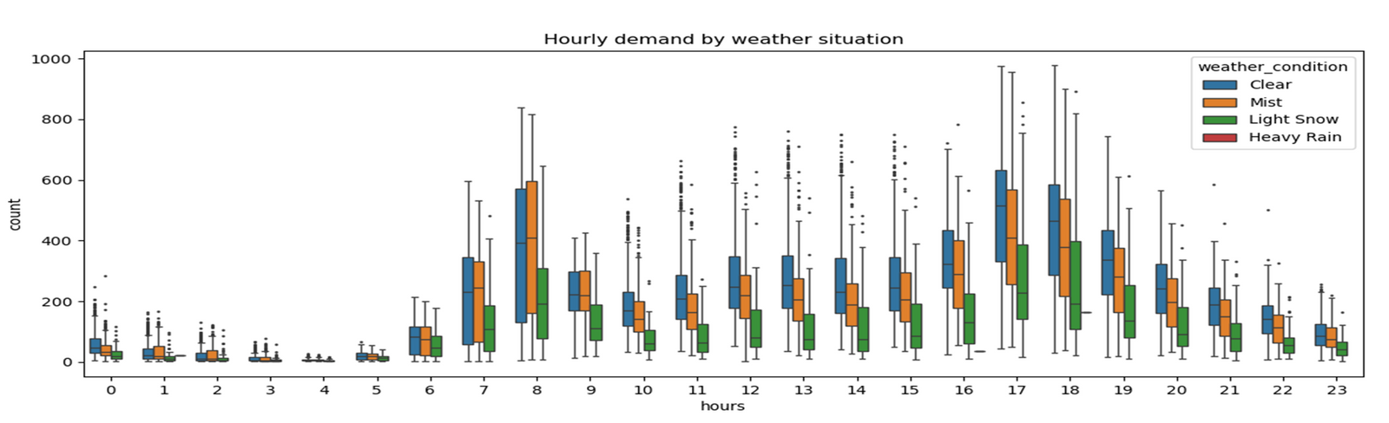
Page 07
WEATHER IMPACT ON HOURLY DEMAND
Demand patterns vary significantly across weather conditions, with clear weather showing consistently higher usage during daytime hours.
These data points represent real-world behavior (e.g., weekends, holidays, weather shifts) and carry valuable predictive signals.
Peak demand occurs between 7 AM and 7 PM, especially under favorable weather, indicating strong commuter and leisure usage.
This insight supports the need for weather-aware forecasting models and dynamic resource allocation during peak hours.

Slide 8
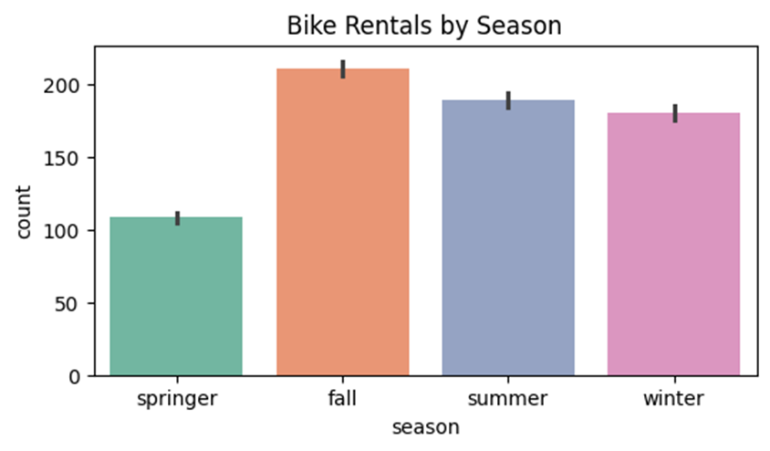
Page 08
SEASONAL DEMAND TRENDS
Fall season recorded the highest bike rental activity, indicating favorable weather and increased outdoor mobility.
Summer and winter showed moderate demand, suggesting consistent usage despite temperature extremes.
Spring had the lowest rental count, possibly due to transitional weather or lower tourist activity.
Error bars highlight variability within each season, reinforcing the need for season-aware forecasting and planning.

Slide 9
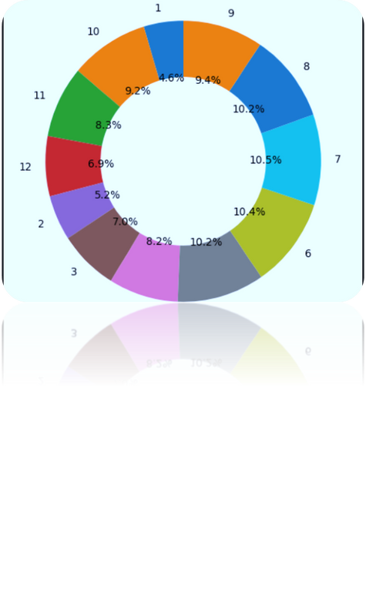
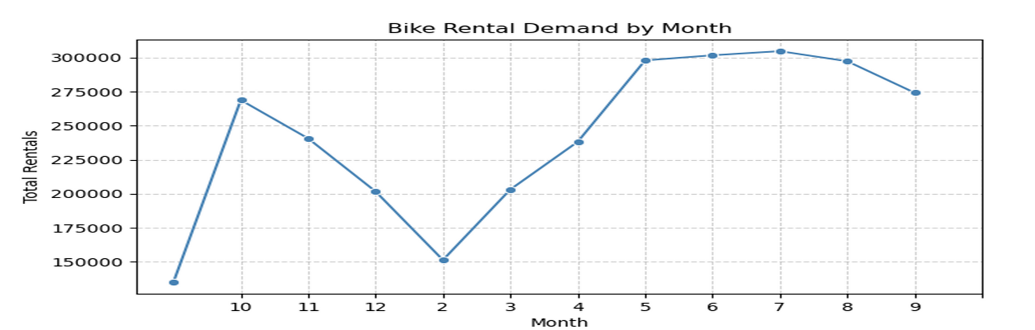
Page 9
BIKE RENTAL DEMAND BY MONTH
Rentals peak in summer months (May–August), aligning with favorable weather.
Winter months (December–February) show the lowest activity.
Spring and fall offer steady but moderate usage, suggesting transitional weather still supports biking.

Slide 10
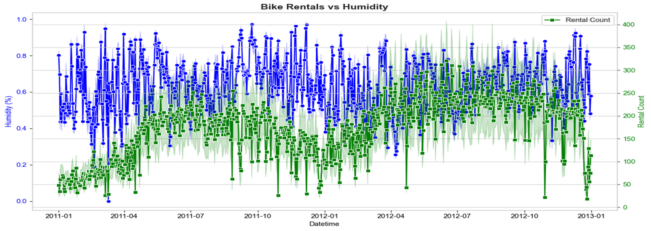
Page 10
HUMIDITY VS RENTAL DEMAND
The time series plot reveals an inverse relationship between humidity and bike rental activity over time.
Periods of high humidity often coincide with lower rental counts, suggesting reduced outdoor activity in damp conditions.
Despite seasonal fluctuations, rental demand shows strong periodic patterns, indicating consistent user behavior across years.
This insight supports the integration of weather variables into predictive models for more accurate demand forecasting.

Slide 11
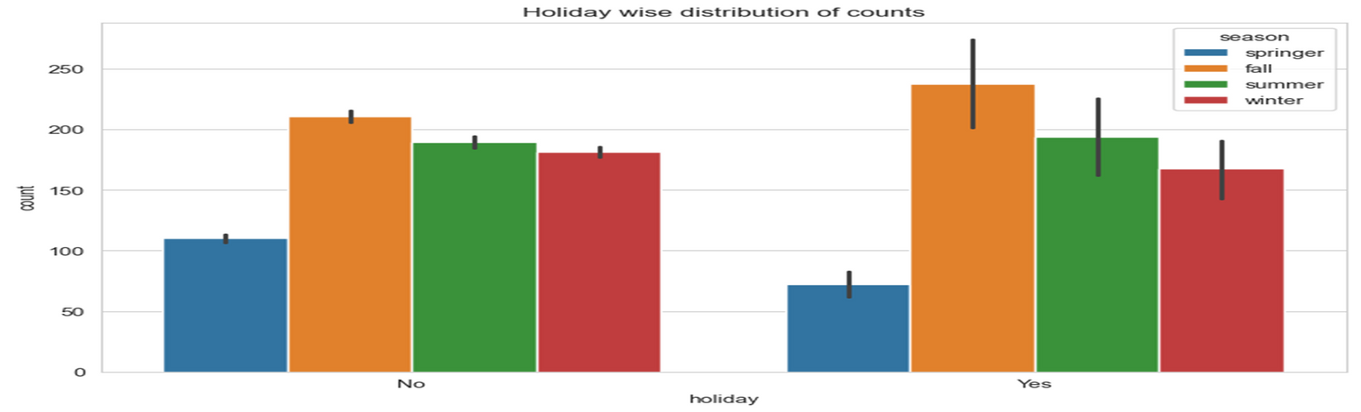
Page 11
HOLIDAY IMPACT ACROSS SEASONS
Fall season consistently shows the highest rental counts, both on holidays and non-holidays, highlighting strong demand regardless of calendar status.
Holiday periods generally see slightly higher rental activity across all seasons, suggesting reduced commuter usage and possible shifts in travel behavior.
Spring remains the lowest-performing season in both categories, reinforcing its limited contribution to overall demand.
These insights support the need for seasonal and calendar-aware planning, especially for fleet distribution and promotional targeting

Slide 12
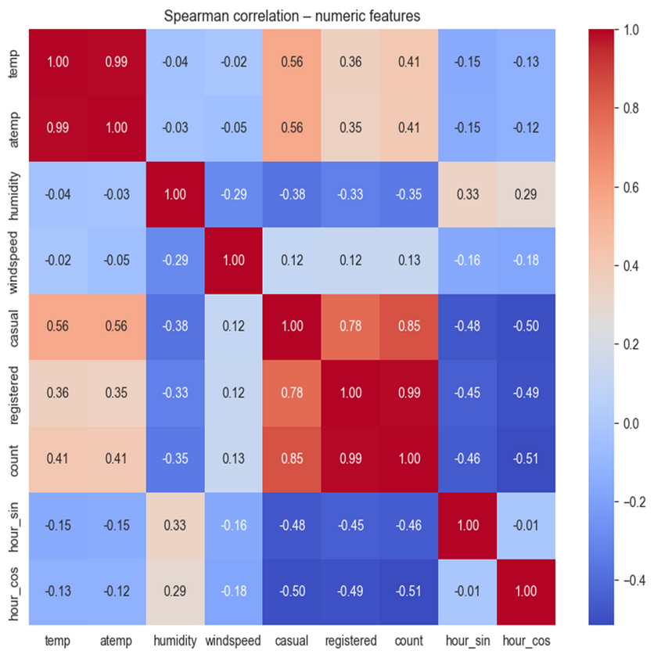
Page 12
SPEARMAN CORRELATION HEATMAP
temp and atemp shows a positive correlation (0.99), so both give similar information.
Bike rental count (count) has a strong positive relationship with both casual and registered users(0.99).
Temperature (temp, atemp) is moderately positively correlated with rentals, especially for casual users (0.56), showing higher usage in warm conditions.
Humidity has a moderate negative correlation with bike rentals, indicating reduced usage in more humid weather.
windspeed shows very weak correlation, suggesting minimal impact on rental demand.
Cyclical time features (hour_sin, hour_cos) show negative correlation with rentals, capturing daily usage patterns across different hours.

Slide 13
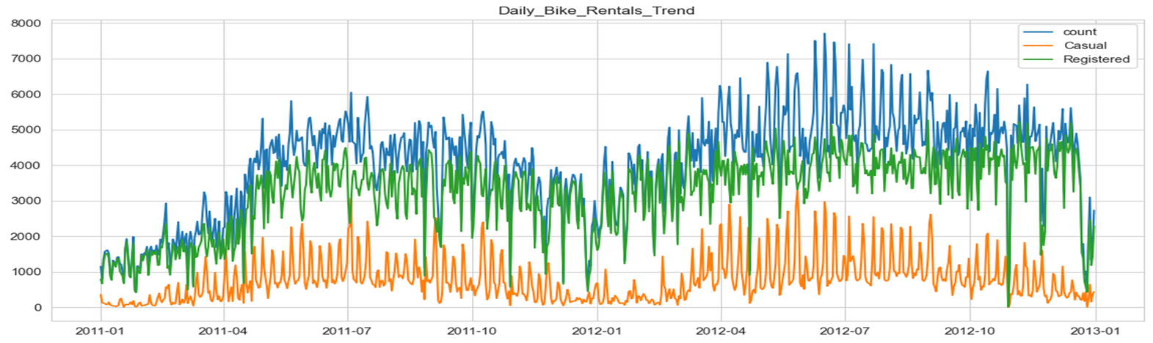
Page 13
DAILY BIKE RENTALS TREND
Total bike rentals show an increasing trend over time, indicating growing usage of the bike rental system.
Registered users consistently contribute the majority of rentals, compared to casual users.
Casual rentals fluctuate more, showing sharp peaks and drops, especially during favorable seasons.
Seasonal patterns are visible: rentals are higher during mid-year (summer) and lower at the beginning and end of the year (winter).
Short-term drops in rentals suggest the impact of weather conditions or holidays.

Slide 14
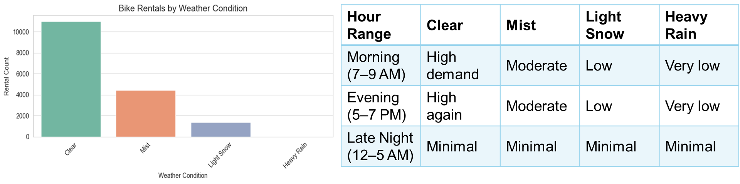
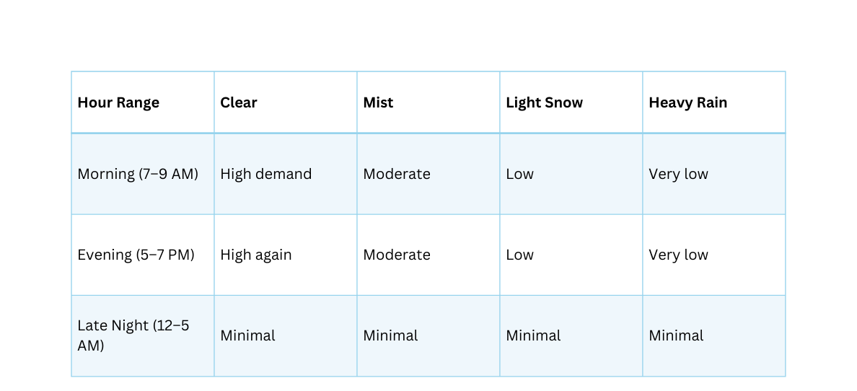
Page 14
BIKE RENTALS BY WEATHER CONDITION
Clear weather drives the highest bike rentals over 10,000 rides. This suggests ideal biking conditions lead to strong demand.
Mist still sees moderate usage around 4,500 rentals indicating that light fog or haze doesn’t deter riders significantly.
Light snow causes a sharp drop rentals fall to around 1,500, showing cold or slippery conditions reduce biking.
Heavy rain shows virtually no rentals confirming that severe weather is a major deterrent

Slide 15
Group No. 5
Page 15
MODEL BUILDING

Slide 16
Page 16
MODEL SELECTION
Multiple machine learning regression models were trained and compared to identify the most suitable model for bike rental prediction.
The models evaluated include:
Decision Tree Regressor
Random Forest Regressor
Gradient Boosting Regressor
XGBoost Regressor
LightGBM Regressor
K-Nearest Neighbors (KNN)

Slide 17
Page 17
MODEL SELECTION
Each model was evaluated using standard performance metrics:
MAE (Mean Absolute Error)
MSE (Mean Squared Error)
RMSE (Root Mean Squared Error)
R² Score
Ensemble and boosting models showed better performance compared to single models.
LightGBM (XG Boost) achieved the lowest error values and highest R² score, indicating better prediction accuracy.
Hence, LightGBM (XG Boost) was selected as the final model for bike rental demand prediction.

Slide 18
Page 18
WHY XGBOOST ?
XGB (Extreme Gradient Boosting) is a machine learning algorithm that combines multiple decision trees to make highly accurate predictions by learning from previous errors.
Reasons for choosing XGBoost:
Bike rental demand shows complex non-linear relationships with factors like weather, season, holidays, and time.
XGBoost handles non-linear patterns effectively using ensemble boosting of decision trees.
Efficient handling of missing values and outliers compared to traditional models.
Performed better than Linear Regression, Decision Tree, Random Forest, and KNN in terms of evaluation metrics (RMSE / R²).

Slide 19
Page 19
MODEL TRAINING PROCESS
Steps followed in model training:
Selected important features affecting bike rentals
Initialized XGBoost Regressor
Applied GridSearchCV for hyperparameter tuning
Trained the model using the training dataset
Generated predictions on test data

Slide 20
Page 20
MODEL EVALUATION

Slide 21
Page 21
MODEL EVALUATION METRICS
The model was evaluated using the following metrics:
MAE (Mean Absolute Error) – average prediction error
MSE (Mean Squared Error) – penalizes large errors
RMSE (Root Mean Squared Error) – interpretable error measure
R² Score – measures how well the model explains the variance

Slide 22
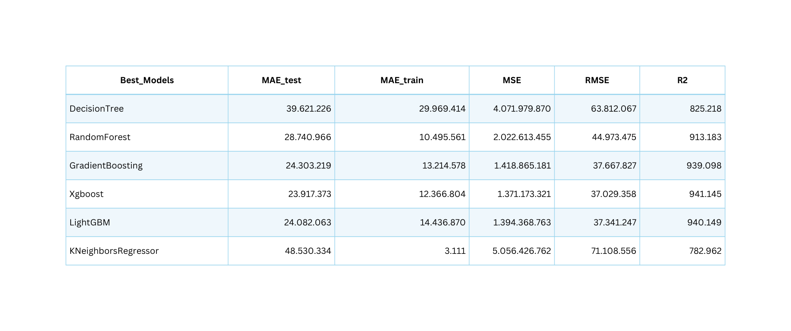
Page 22
MODEL PERFORMANCE COMPARISON
Decision Tree shows the lowest performance, with higher error values and a lower R² score, indicating limited prediction accuracy.
XGBoost significantly improves performance, with lower error metrics and a high R² value (~0.94).
LightGBM performs best among all models, achieving the lowest error values and the highest R² score (~0.94).
The results show that ensemble models outperform single models like Decision Tree.
Based on overall performance, LightGBM is selected as the final model for bike rental prediction.

Slide 23
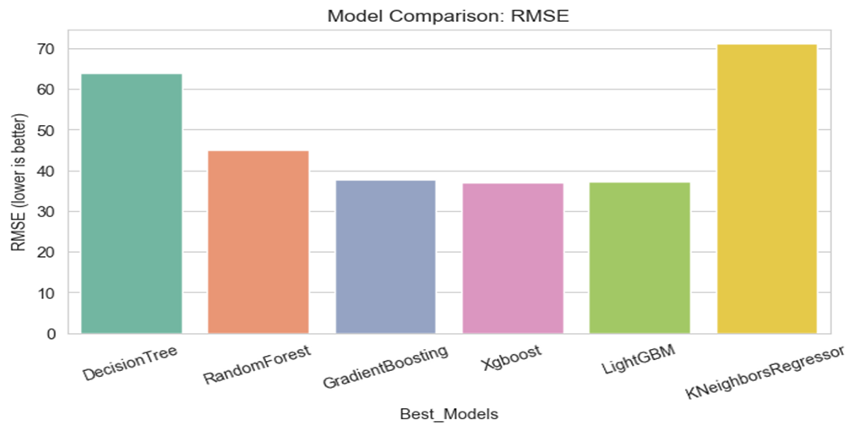
Page 23
MODEL COMPARISON (RMSE)
RMSE measures prediction error; lower values indicate better model performance.
LightGBM, XGBoost, and Gradient Boosting show the lowest RMSE, meaning they predict bike rentals more accurately.
Decision Tree has a higher RMSE, indicating weaker performance.
K-Nearest Neighbors (KNN) shows the highest RMSE, making it the least accurate model in this comparison.
Overall, ensemble boosting models outperform traditional models.

Slide 24
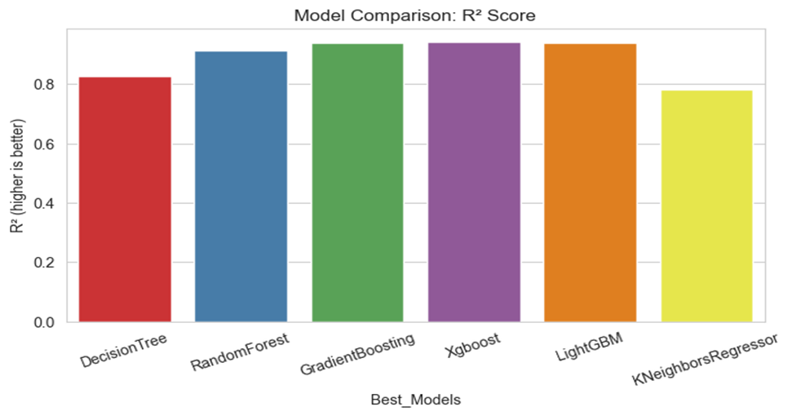
Page 24
MODEL COMPARISON (R² SCORE)
R² score shows how well the model explains the data (higher is better).
XGBoost and LightGBM achieve the highest R² values, indicating very strong prediction performance.
Gradient Boosting and Random Forest also perform well with high R² scores.
Decision Tree has a lower R² score compared to ensemble models.
KNN Regressor shows the weakest performance in explaining bike demand.

Slide 25
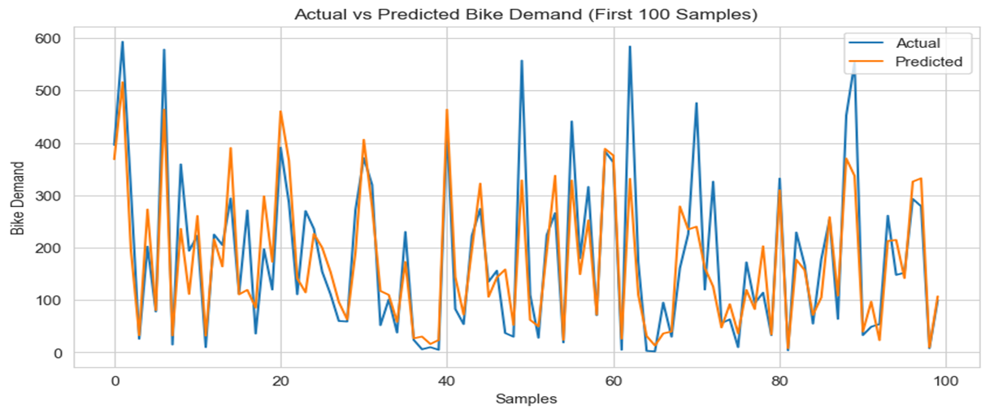
Page 25
ACTUAL VS PREDICTED BIKE DEMAND
The predicted values closely follow the actual bike demand, showing good model accuracy.
The model successfully captures ups and downs in bike rentals.
Small deviations between actual and predicted values indicate minor prediction errors.
Overall, the model demonstrates strong generalization and reliable performance.

Slide 26
Page 26
CONCLUSION
The XGBoost which gave the best result for Predicting Rented Bike Count using several Features on both train and test data with R2score of 0.94.
There is no. use of removing outliers ,it affects negatively on model performance.
The bike rental prediction system was successfully developed using machine learning techniques.
Proper data preprocessing and feature selection helped improve model performance.
Multiple regression models were trained and evaluated using standard metrics.
XGBoost was selected as the final model due to its high perfomrance and low error values.
The model can effectively predict bike rental demand and assist in better planning and decision-making.

Slide 27
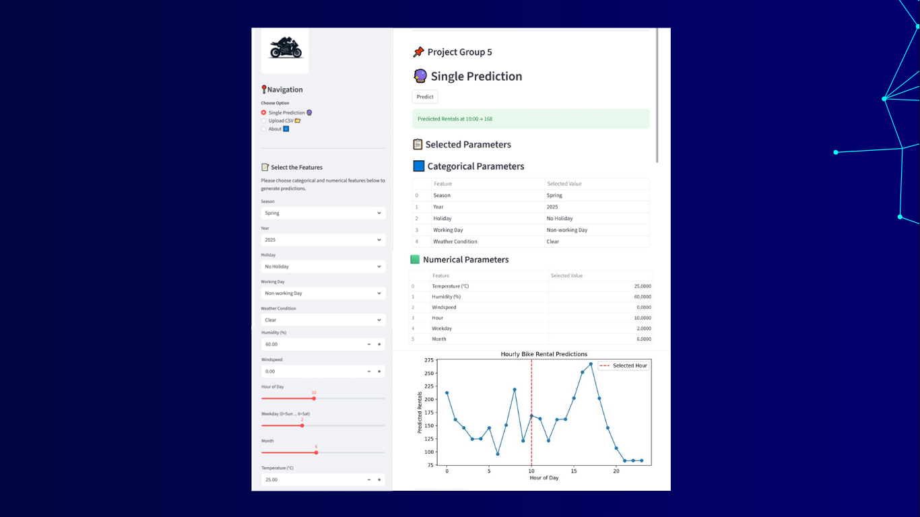
Page 28

Slide 28
Page 28
CHALLENGES FACED DURING THE PROJECT
Outlier Handling: Significant outliers were found in weather features like humidity and windspeed. Care was taken to remove only irrelevant outliers while preserving meaningful demand patterns.
Data Cleaning Issues: Some numerical columns were stored as object types and contained invalid characters (e.g., ?), requiring careful data cleaning and type conversion.
Feature Engineering Complexity: Time-based features were converted into cyclical features (sin/cos), which required additional logic and consistency handling during model deployment.
Model Selection & Tuning: Multiple regression models were tested. Achieving optimal performance required extensive hyperparameter tuning, especially for Gradient Boosting models.
Overfitting: Certain models performed well on training data but poorly on test data, requiring tuning to improve generalization.
Evaluation Metric Interpretation: Comparing metrics such as MAE, MSE, RMSE, and R² to select the best model was challenging and required careful analysis.

Slide 29
Page 29
THANKYOU

